Slide 1
August 15
2018
TownePlace Suites
by Marriott
GPA2018-0002, ZA2018-0001, CUP2018-0009, CUP2018-0011, ME2018-0006, TPM No. 78325, and GPC2018-0003
Notes:
Good afternoon, Chair and members of the Development Review Committee
It is my pleasure to present to you the proposed Monrovia TownePlace Suites by Marriott.

Slide 2
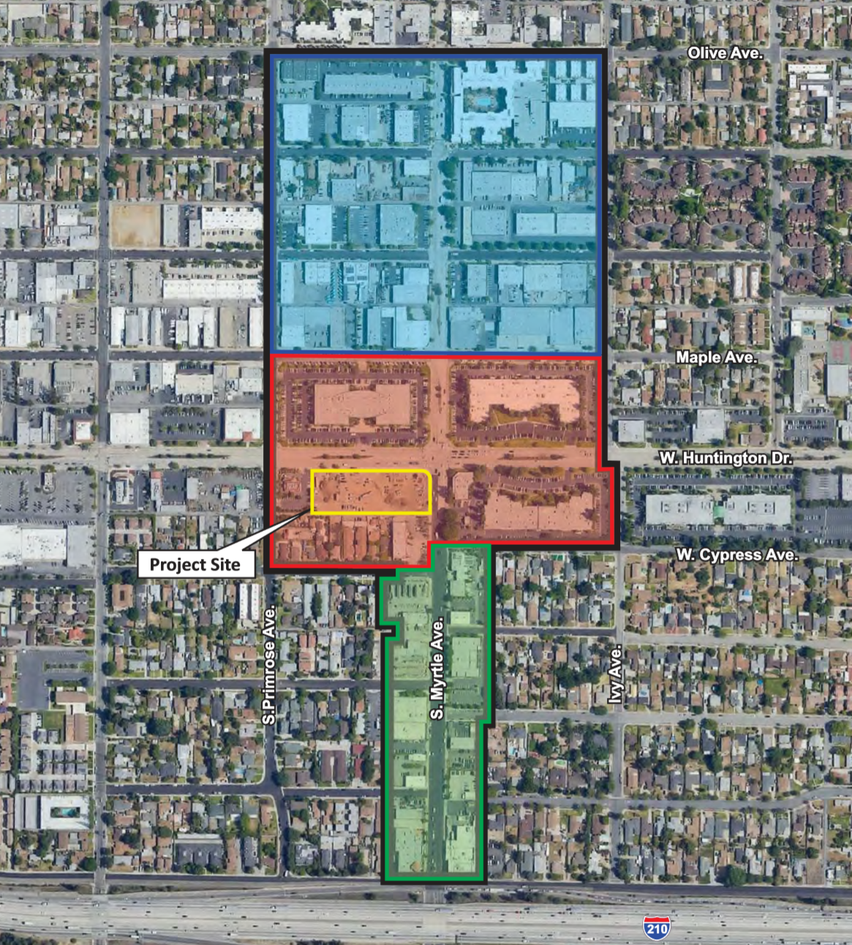
General Plan – Planning Area
South Myrtle Avenue Corridor
Notes:
From a land use standpoint, the property is located within the City’s South Myrtle Avenue Corridor planning area.
As with each of the land use planning areas identified in the General Plan, this planning area has a defined land use vision.
The vision of the South Myrtle Avenue Corridor Planning Area has been and continues to be to connect the City’s historic downtown, on Myrtle Avenue, to the 210 Freeway and to eventually create a proper gateway into the City of Monrovia.
The South Myrtle Avenue Corridor Planning Area is divided into three distinct areas: Old Town Extension, Crossroads District, and South Myrtle Corridor. Creating three distinct neighborhoods is intended enliven the street and address the issues related to that particular neighborhood.

Slide 3
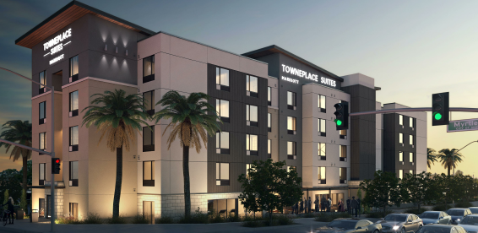
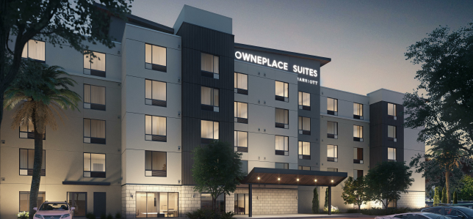
Planning Commission
ADVISORY REVIEW
TownePlace Suites by Marriott
Applicant, Theraldson Hospitality
Notes:
The Applicant is proposing to construct a transit-oriented, 5-story multi-family residential development consisting of 296 apartment units, including 6 live/work units. The project includes three private courtyards, a public open space area along South Magnolia Avenue, and a 6-story (7-level) parking structure consisting of 518 parking spaces. The project also proposes to change Peck Road north of Duarte Road to a publicly accessible driveway and drop-off area for the adjacent Metro Gold Line Monrovia Station.

Slide 4
REQUIRED APPROVALS
General Plan Amendment (LUE text and map)
Zoning Amendment (text and map)
Tentative Parcel Map
Conditional Use Permit
Minor Exception
Finding of General Plan Conformity
Mitigated Negative Declaration (MND)
Notes:
A project of this size, comes with many land use entitlement requests which are as follows.
Specific Plan – establishes land use regulations, development standards, and design guidelines
Zoning Ordinance Amendment to for both a text and map amendment
Tentative Parcel Map is proposed to consolidate 6 parcels and the terminus of Peck Road north of Duarte Road into one 3.79 acre site. It is important to note that a separate public hearing process will be required for a street vacation. This process would commence at a later date after the City Council considers and acts on the project tonight.
A conditional use permit is required to allow the construction of a 296 multifamily development, with 6 live/work units, with a parking structure providing 522 spaces
Lastly, give the size of the project a thorough environmental review process was undertaken which yielded a proposed Mitigated Negative Declaration that was prepared in accordance with the California Environmental Quality Act as the environmental clearance document for the project. (I will speak more about the Mitigated Negative Declaration later in this presentation).

Slide 5
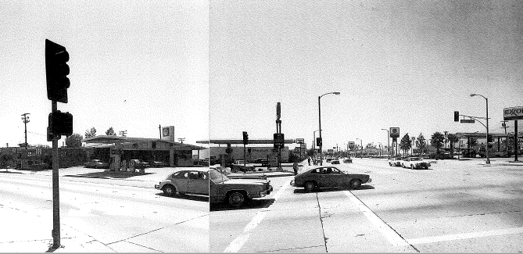
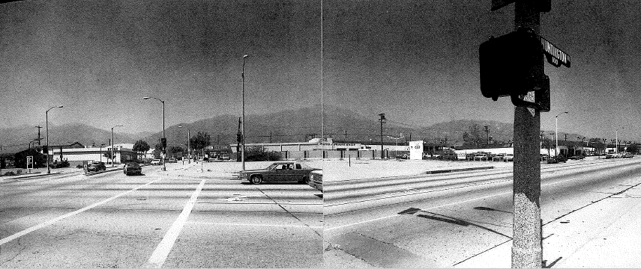
Myrtle & Huntington

Slide 6
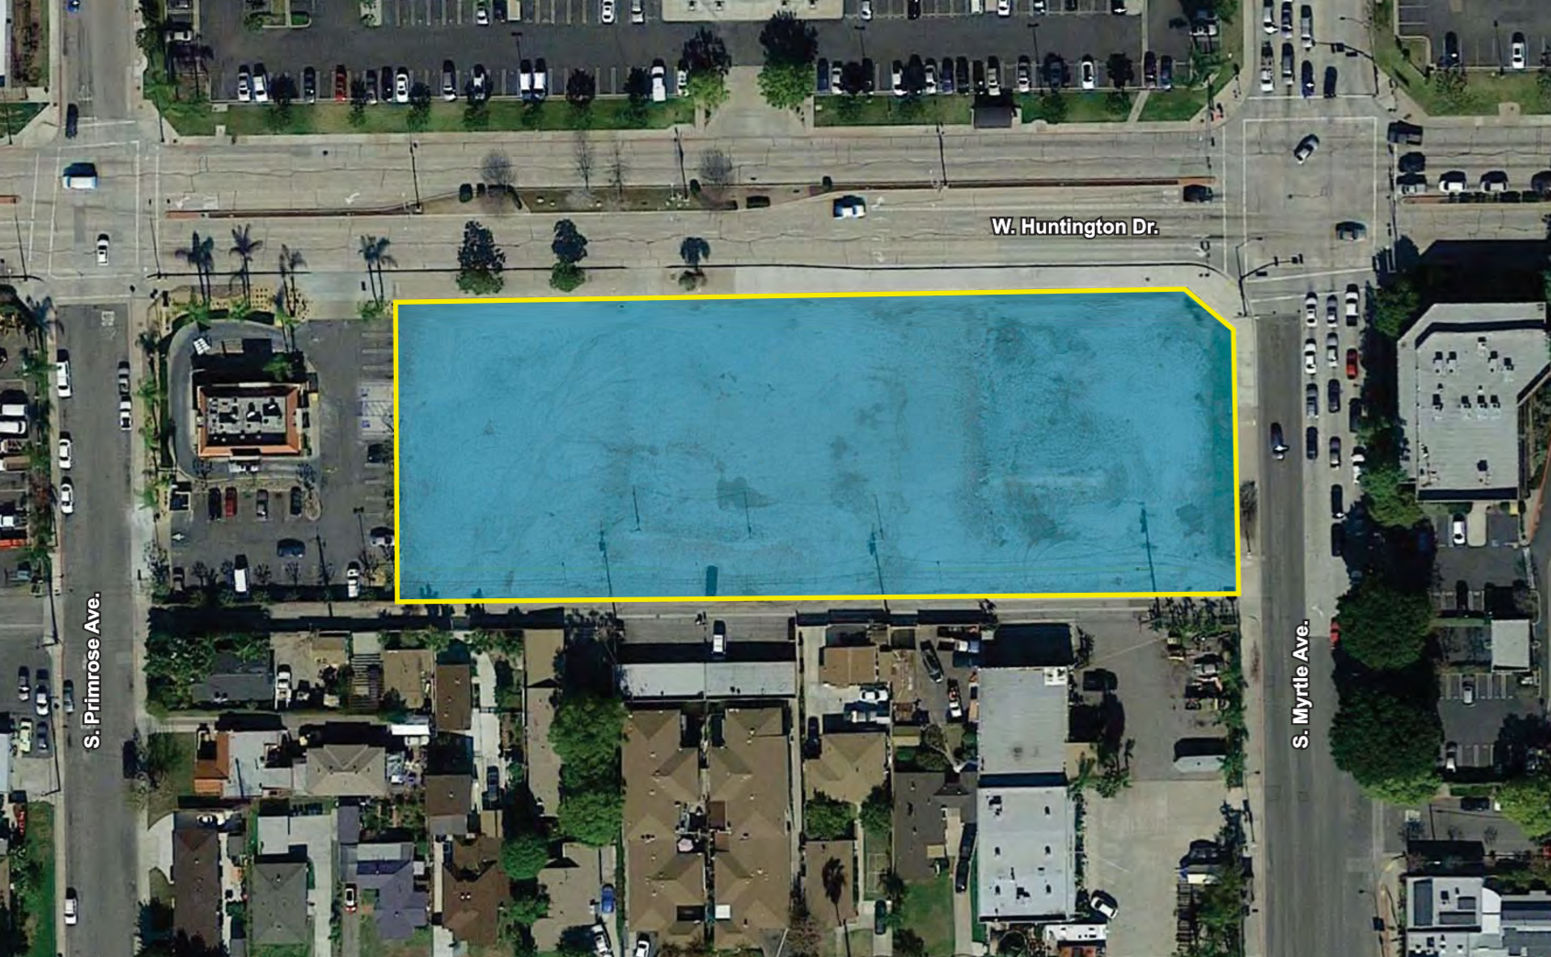
Project Location
N
Notes:
The project site is located on the southwest corner of W Huntington Drive and S Myrtle Avenue. The site consists of a vacant lot consisting of 6 vacant parcels which total approximately +/- 1.77 acres of land.
It was once developed with a residential structure and a gasoline station dating back to the late 1920s. The residence was demolished in 1977 and the gasoline station and tank removal process) completed in 2002. The site has been vacant ever since.

Slide 7
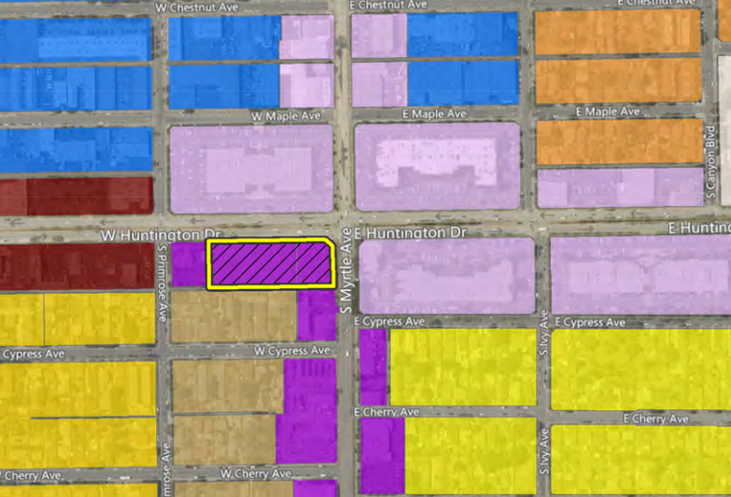
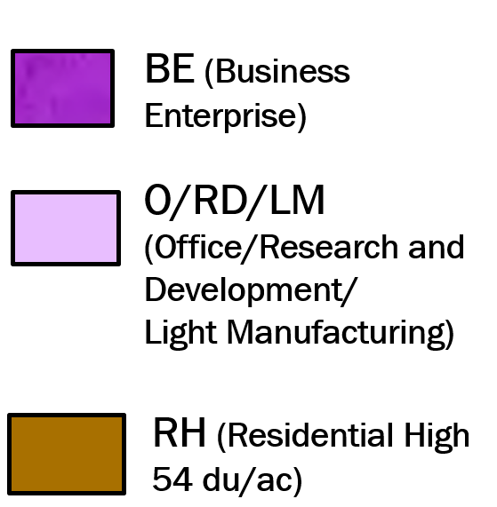
The Cross Roads District
Land Use and Zone Designations
W Maple Ave
E Maple Ave
BE (Business Enterprise)
Primrose Ave
S Ivy Ave
O/RD/LM (Office/Research and Development/
Light Manufacturing)
Cypress Ave
BE to O/RD/LM
Notes:
The Cross Road District primarily encompasses the intersection of Myrtle Avenue and Huntington Drive which is the busiest intersection in the City. This area is also highly accessible from the freeway, and is where the Old Town extension meets the high-tech corridor.
The Cross Roads District bounded by Maple on the north, Cypress on the south, Primrose on the west and Ivy on the east)

Slide 8
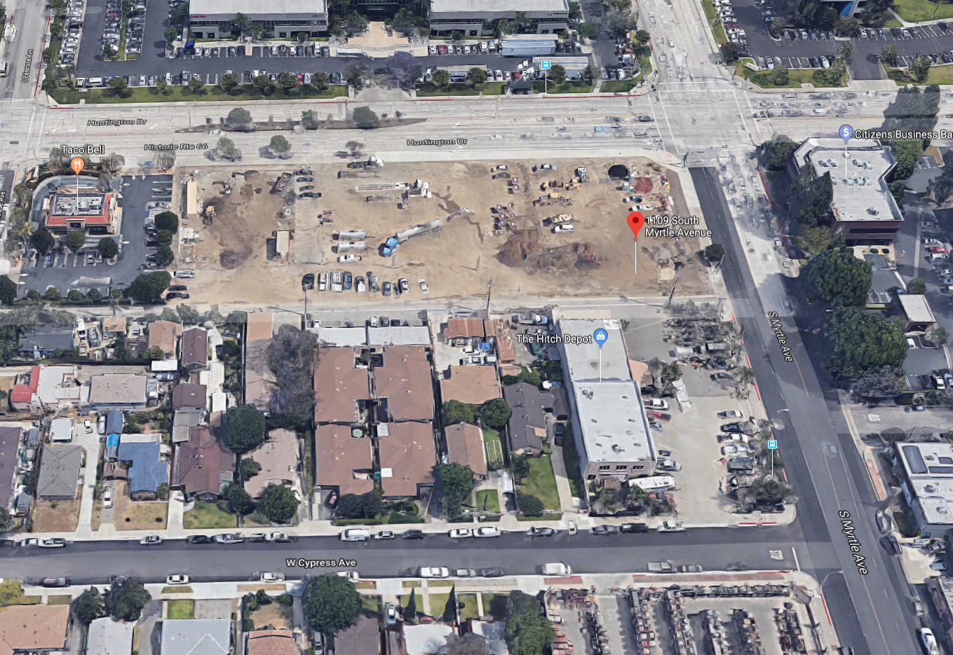
Existing Neighborhood Context
WorelyParsons
WorelyParsons
West Huntington Drive
Citizens Bank
Taco Bell
S Myrtle Avenue
Hitch Depot
W Cypress Avenue

Slide 9
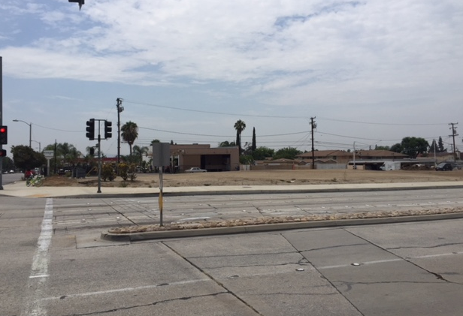
Existing Site
102 – 140 W Huntington Drive
Notes:
The former Monrovia Redevelopment Agency acquired the site between 2002 and 2005 for the purpose of assembling a high profile, quality project that would contribute to the high tech corridor that was evolving along the east Huntington Drive.
As the DRC knows, the all Redevelopment Agencies in California were dissolved in 2012. Upon the dissolution of the redevelopment agency, the property ownership transferred to the City’s Successor Agency.
In early 2016 staff began assessing several different development options for the Site. After completing a significant amount of market research and analysis, Staff learned that the Monrovia business market had a need and could easily absorb a hotel land use.
For this reason, the City initiated a Request for Qualifications (RFQ) process and shopped the hospitality industry for a business operation that would be a good match for Monrovia. The City was diligent if finding an operator who would become the City’s partner.
Theraldson Hospitality Group was identified as the preferred partner. Consequently, the Oversight Board of the Successor Agency and the City entered into a Purchase and Sales Agreement with Theraldson pursue the development of a hotel project at the Site.

Slide 10
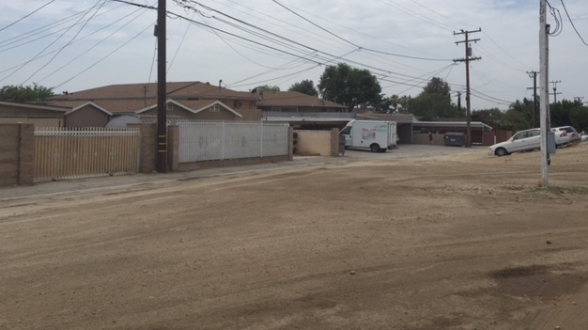
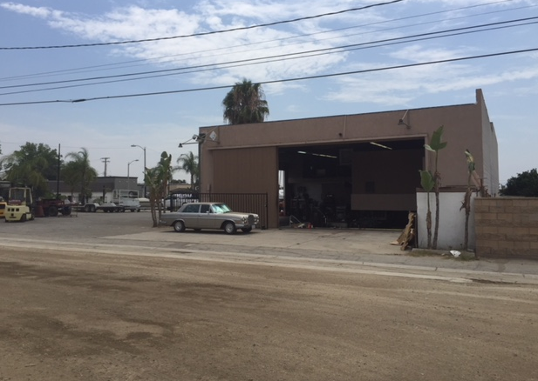
Existing Neighborhood Context
Notes:
Neighborhood Compatibility
Neighborhood Compatibility was a key consideration for the project’s design to successful given its proximity to

Slide 11
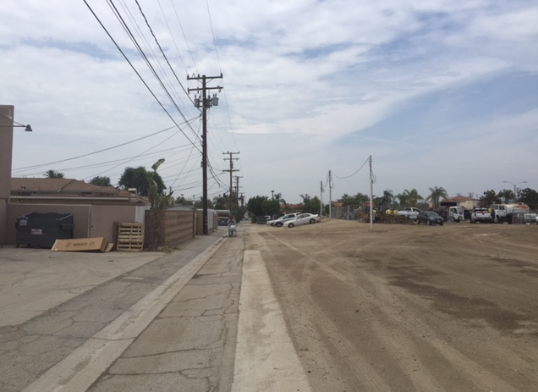
Existing Neighborhood Context
Notes:
Neighborhood Compatibility
Neighborhood Compatibility was a key consideration for the project’s design to successful given its proximity to

Slide 12
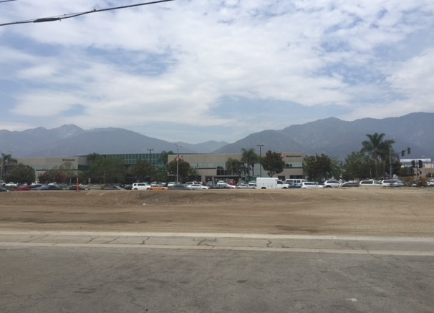
Existing Neighborhood Context
Notes:
Neighborhood Compatibility
Neighborhood Compatibility was a key consideration for the project’s design to successful given its proximity to

Slide 13
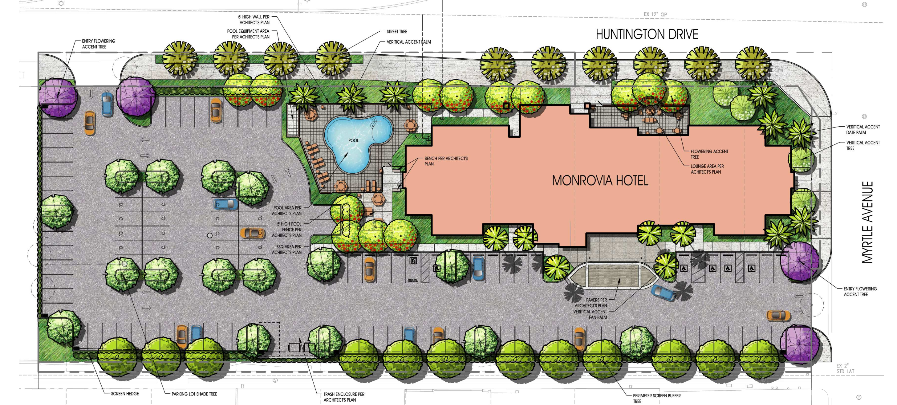
Site Plan
HUNTINGTON DR
Street Entrance
Monrovia Hotel
Lounge Area
Parking Lot Entrance
S MYRTLE AVE
Notes:
Appropriate site planning and design was considered for this hotel project given its location within the Cross Roads District planning area, as well as its proximity to multifamily residential properties directly to the south of the subject site.
The building foot totals 14,000 SF, and it was place as close to the corner of the site as possible to engage the street intersection and showcase the building’s focal point. This set back from the south property boundary also reduces the overall scale and mass of the building.
The building proposes to main entrances (a street entrance on Huntington Drive, and a Parking lot entrance from the south of the building.)
To further enhance the pedestrian experience in front of the building, an active outdoor lounge area is proposed adjacent to the street entrance. A large corner landscaped area is proposed, as well as an enhanced side entrance off South Myrtle Avenue.
The proposed Project would include on-site lighting consisting of mounted parking lot lighting (approximately 25 ft. in height), low-level bollard lighting (approximately 3 ft. in height), and wall-mounted lighting. All lighting would be hooded or shielded to focus the light downward and prevent light spillage onto adjacent properties.
The landscaping plan for the Project site would include a mix of trees and shrubs. Specifically, flowering accent trees and perimeter landscaping would line the northern and eastern boundaries of the site, a screen hedge (3.5 to 4 ft. in height) and a row of screen buffer trees would line the southern boundary of the site, and ornamental trees and landscaping would be scattered throughout the on-site parking lot.

Slide 14
Parking – Minor exception
Parking spaces proposed – 109 for 109 rooms.
Minor Exception proposed to allow 23 compact spaces in lieu of standard sized spaces. 109 total spaces will be provided.
Standard spaces are 8’-6” x 18”
Compact spaces proposed are 8’-6” x 16’

Slide 15
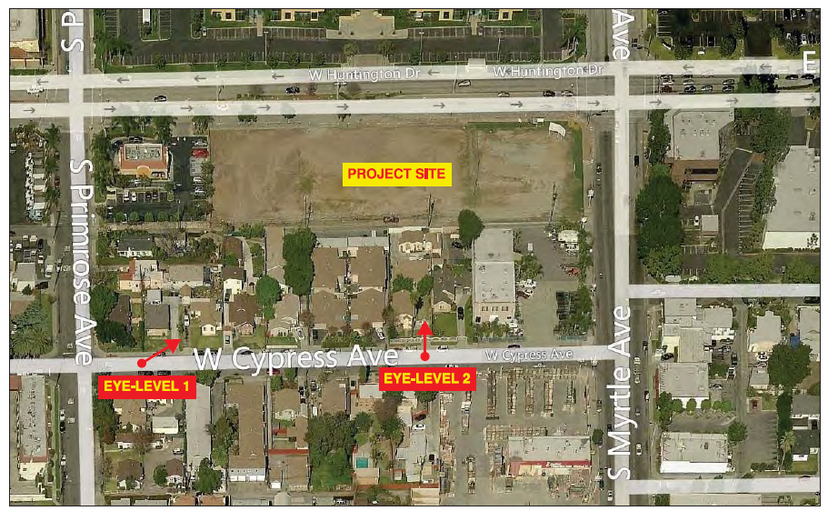
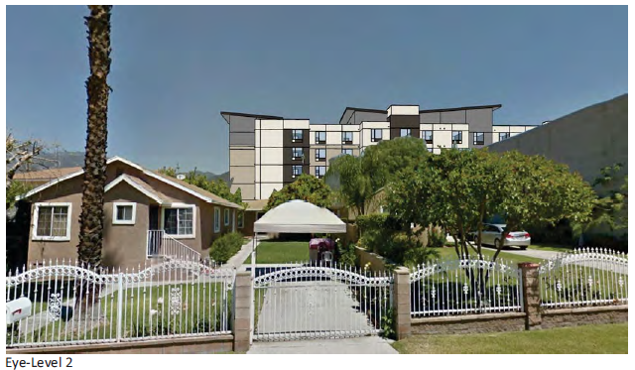
Line of Sight
Notes:
Line of Sight Figures, implementation of the proposed Project would partially block views of the San Gabriel Mountains from public vantage points along West Cypress Avenue and residential uses south of the site. While the partial obstruction of views of the San Gabriel Mountains would occur as a result of Project implementation, the overall views of the mountains would not be substantially affected by development of the site due to the prominence of the San Gabriel Mountains. Furthermore, landscaping elements included as part of the Project would serve to enhance and frame views of the mountains from roadways and sidewalks within the project vicinity. For

Slide 16
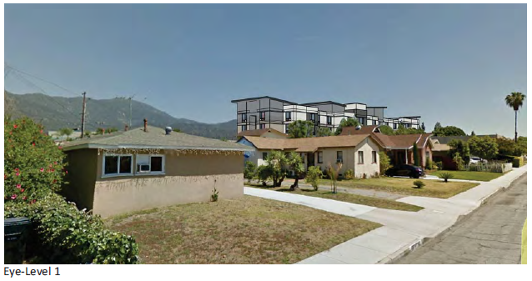
Line of Sight
Notes:
Line of Sight Figures, implementation of the proposed Project would partially block views of the San Gabriel Mountains from public vantage points along West Cypress Avenue and residential uses south of the site. While the partial obstruction of views of the San Gabriel Mountains would occur as a result of Project implementation, the overall views of the mountains would not be substantially affected by development of the site due to the prominence of the San Gabriel Mountains. Furthermore, landscaping elements included as part of the Project would serve to enhance and frame views of the mountains from roadways and sidewalks within the project vicinity. For

Slide 17
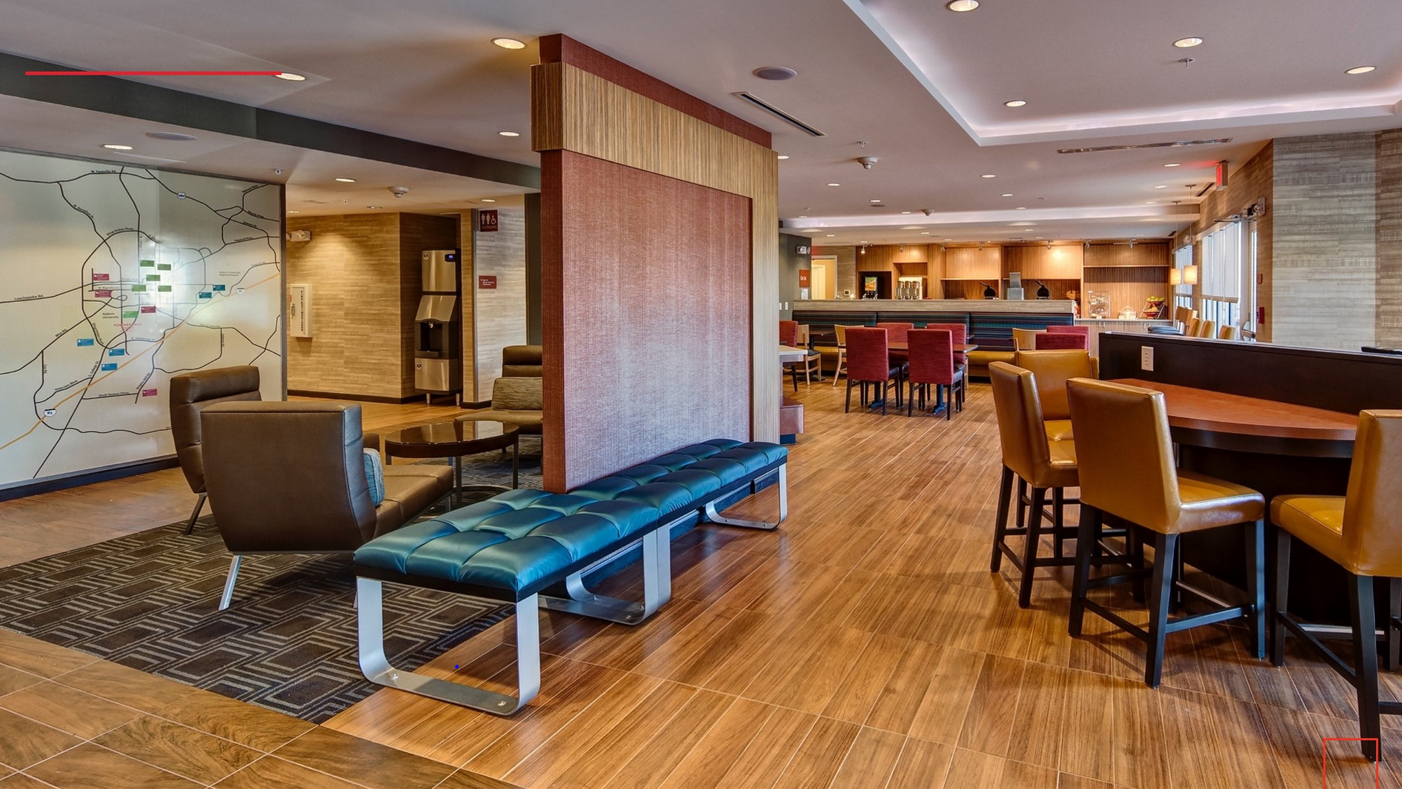
Hotel Operation
TownePlace Suites by Marriot
109-Room Hotel
Three Major Room Types with fully equipped kitchens
One-bedroom
Double-queen
King Studios
Amenities
Main lobby
Small Market
Business Services
Exercise room
Breakfast room
Pool
Notes:
TownePlace Suites offers king studio, double queen and one-bedroom suites with fully-equipped kitchens and separate living/working and sleeping areas.
TownePlace Suites acclimates their guest to the City their located through the TowneMap® map wall, which displays local favorite restaurants, services and attractions.
Business services - such as copying, faxing and printing, free Wi-Fi, available.
A separate seating area and buffet, offers complimentary hot breakfast daily.
Amenities
Exercise room provided for those looking for a workout during their stay.
Outdoor pool.
Outdoor seating with fire pit.
Dry-cleaning services available, as well as guest laundry.
Meeting Room.

Slide 18
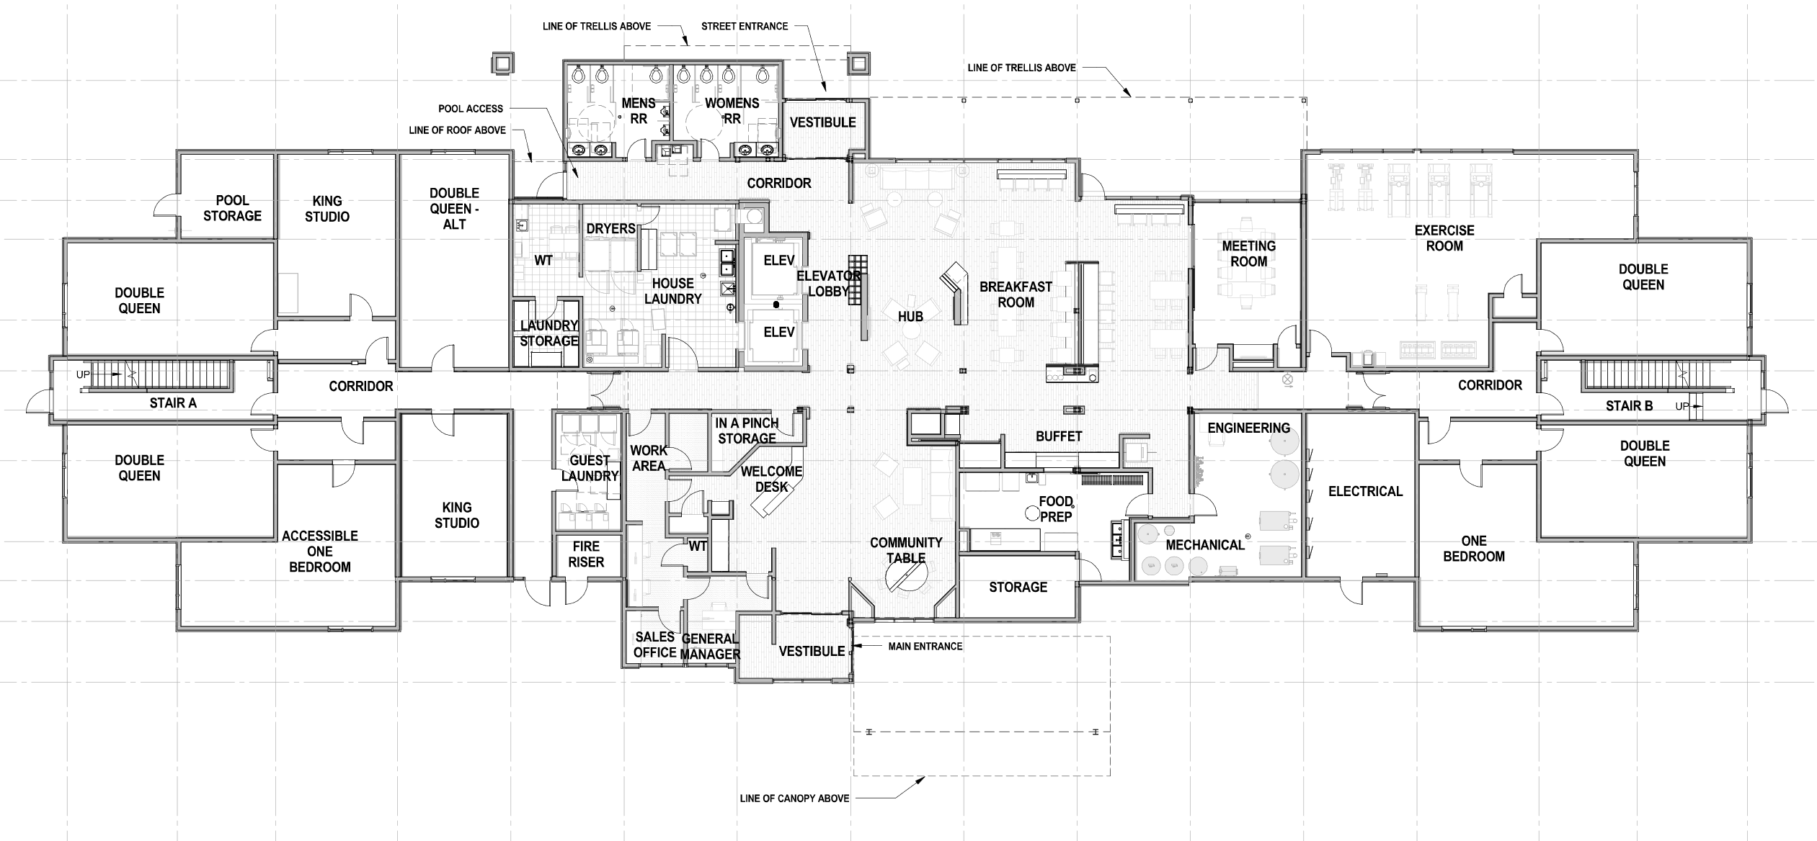
Floor Plan
FIRST FLOOR
Street Entrance
Breakfast Room
Exercise Room
House Laundry
Meeting Room
HUB
Guest Laundry
Buffet
Community Table
Main Entrance

Slide 19
Exterior Elevations
65’-0”
61’-0”
View from Huntington Drive
Notes:
The hotel features varied façades and roof lines, large windows, and a modern color palette that would create interest and highlight the varied building features. Building materials on the ground floor would be stone veneer, and painted Exterior Insulation and Finish System (EIFS) would be utilized for the upper floors of the building. The hotel would also include a metal roof, fiber cement siding panels on the building façade, and aluminum mechanical grills around the windows.

Slide 20
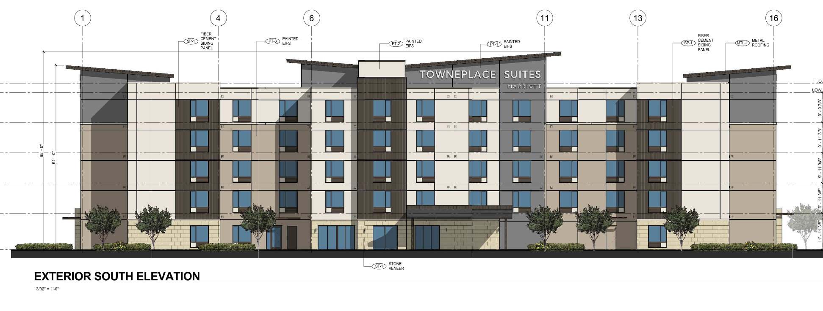
Exterior Elevations
65’-0”
61’-0”
View from Alley

Slide 21
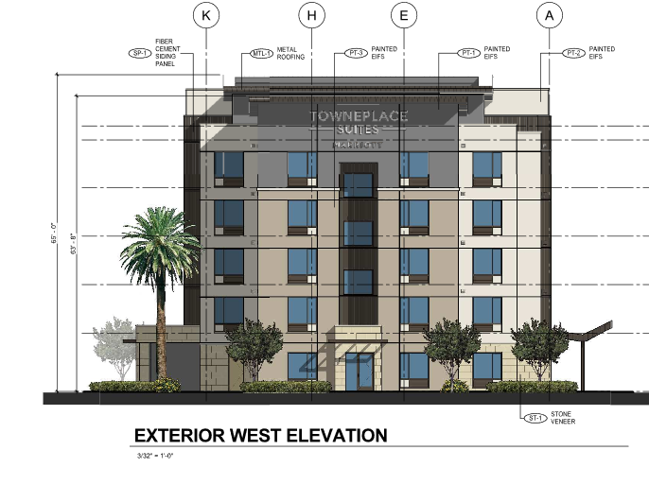
Exterior Elevations
View from Adjacent Property (Taco Bell)
65’-0”
61’-0”

Slide 22
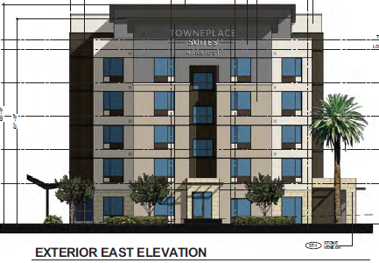
Exterior Elevations
View from South Myrtle Avenue

Slide 23
General Plan/Zoning Amendments
Amend the land use and zoning designations from Business Enterprise (BE) to Office/Research and Development /Light Manufacturing (O/RD/LM) (GP/ZO)
Add hotel use as a conditional use within the O/RD/LM Land Use and zoning designation in the Crossroads District. (GP/ZO)
Increase the height limit from 4 to 5 stories. (LUE)
Amend the Floor Area Ratio (FAR) for the O/RD/LM land use designation from .75:1 to 2.0:1. (LUE)
Clean up text changes to Land Use Element to correct typographical errors. (LUE)
Notes:
A project of this size, comes with many land use entitlement requests which are as follows.
Specific Plan – establishes land use regulations, development standards, and design guidelines
Zoning Ordinance Amendment to for both a text and map amendment
Tentative Parcel Map is proposed to consolidate 6 parcels and the terminus of Peck Road north of Duarte Road into one 3.79 acre site. It is important to note that a separate public hearing process will be required for a street vacation. This process would commence at a later date after the City Council considers and acts on the project tonight.
A conditional use permit is required to allow the construction of a 296 multifamily development, with 6 live/work units, with a parking structure providing 522 spaces
Lastly, give the size of the project a thorough environmental review process was undertaken which yielded a proposed Mitigated Negative Declaration that was prepared in accordance with the California Environmental Quality Act as the environmental clearance document for the project. (I will speak more about the Mitigated Negative Declaration later in this presentation).

Slide 24
Other REQESTED APPROVALS
Tentative Parcel Map TPM 78325 to consolidate six existing parcels into one lot.
General Plan Conformity Finding for the acceptance of the proposed ROW dedications.
Notes:
A project of this size, comes with many land use entitlement requests which are as follows.
Specific Plan – establishes land use regulations, development standards, and design guidelines
Zoning Ordinance Amendment to for both a text and map amendment
Tentative Parcel Map is proposed to consolidate 6 parcels and the terminus of Peck Road north of Duarte Road into one 3.79 acre site. It is important to note that a separate public hearing process will be required for a street vacation. This process would commence at a later date after the City Council considers and acts on the project tonight.
A conditional use permit is required to allow the construction of a 296 multifamily development, with 6 live/work units, with a parking structure providing 522 spaces
Lastly, give the size of the project a thorough environmental review process was undertaken which yielded a proposed Mitigated Negative Declaration that was prepared in accordance with the California Environmental Quality Act as the environmental clearance document for the project. (I will speak more about the Mitigated Negative Declaration later in this presentation).

Slide 25
GPC – Offer to Dedicate
HUNTINGTON DR
Street Entrance
Monrovia Hotel
Lounge Area
Parking Lot Entrance
S MYRTLE AVE
Notes:
Appropriate site planning and design was considered for this hotel project given its location within the Cross Roads District planning area, as well as its proximity to multifamily residential properties directly to the south of the subject site.
The building foot totals 14,000 SF, and it was place as close to the corner of the site as possible to engage the street intersection and showcase the building’s focal point. This set back from the south property boundary also reduces the overall scale and mass of the building.
The building proposes to main entrances (a street entrance on Huntington Drive, and a Parking lot entrance from the south of the building.)
To further enhance the pedestrian experience in front of the building, an active outdoor lounge area is proposed adjacent to the street entrance. A large corner landscaped area is proposed, as well as an enhanced side entrance off South Myrtle Avenue.
The proposed Project would include on-site lighting consisting of mounted parking lot lighting (approximately 25 ft. in height), low-level bollard lighting (approximately 3 ft. in height), and wall-mounted lighting. All lighting would be hooded or shielded to focus the light downward and prevent light spillage onto adjacent properties.
The landscaping plan for the Project site would include a mix of trees and shrubs. Specifically, flowering accent trees and perimeter landscaping would line the northern and eastern boundaries of the site, a screen hedge (3.5 to 4 ft. in height) and a row of screen buffer trees would line the southern boundary of the site, and ornamental trees and landscaping would be scattered throughout the on-site parking lot.

Slide 26
Environmental Review
Mitigated Negative Declaration
Initial Study was prepared to evaluate potential impacts. 17 mitigation measures are proposed in the following areas:
Aesthetics
Air Quality
Biological Resources
Cultural Resources
Geology and Soils
Hazards and Hazardous Materials
Hydrology and Water Quality
Noise
Tribal Resources
Utilities and Service Systems

Slide 27
Project Review
Public Outreach Meeting – October 13, 2016
CEQA
Mitigated Negative Declaration was prepared. The 30 day Public Review and Comment Period began on July 16th and ends on August 15th
Development Review Committee – July 18, 2018
Public Hearing Dates
Planning Commission – August 15, 2018 at 7:30 PM
City Council – September 4, 2018 at 7:30 PM

Slide 28
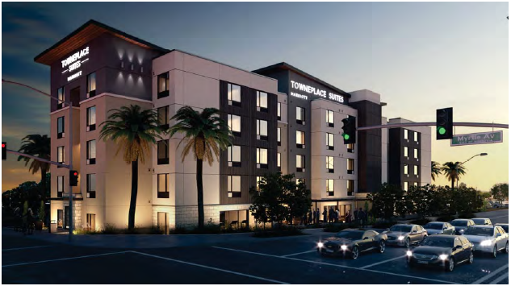
TownePlace Suites

Slide 30
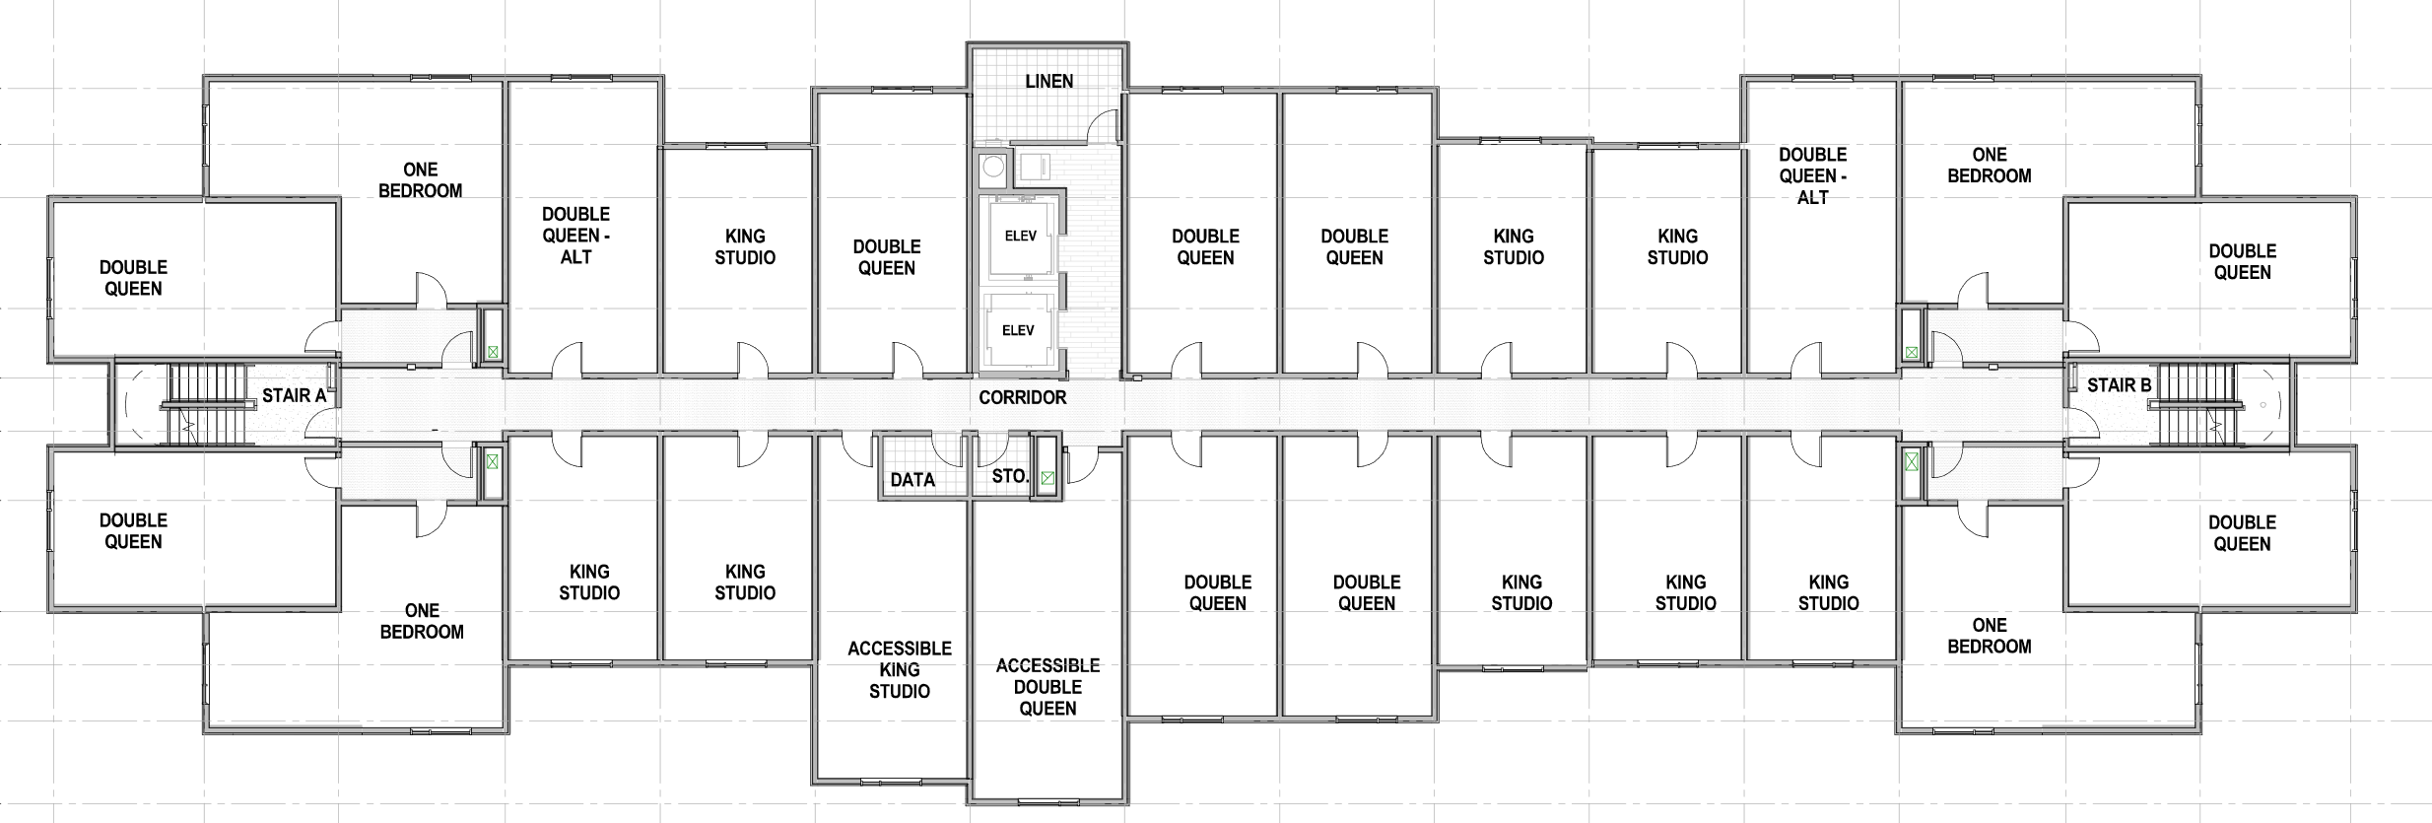
Floor Plan
FLOORS 2 - 5
Breakfast Room
Exercise Room
House Laundry
Meeting Room
HUB
Guest Laundry
Buffet
Community Table

Slide 31
Traffic Study (off-Site)
The TIA evaluated the following ten intersections within the project vicinity:
Myrtle Avenue/Foothill
Myrtle Avenue/Huntington Drive
Myrtle Avenue/Project Driveway
Myrtle Avenue/Central Avenue-Interstate-210 (I-210) westbound ramps (signalized)
Myrtle Avenue/Evergreen Avenue-I-210 eastbound ramps (signalized)
Myrtle Avenue/Duarte Road (signalized)
I-210 eastbound ramps/Huntington Drive (signalized)
I-210 westbound ramps/Huntington Drive (signalized)
Project Driveway 2/Huntington Drive (unsignalized)
Notes:
The analysis concluded that the proposed project would not cause any significant impacts at any of the analyzed intersections and no project-specific mitigation measures would be required.
It is important to note that the traffic study does not imply that there will be no increase in traffic. An increase in the intensity of the use of the site will increase the amount of cars on the street system. However, using the City’s General Plan as a guide, the traffic study has projected that the increased traffic to be less than significant.

Slide 32
Mitigation Monitoring and Reporting Program
AIR-1: Addresses the temporary adverse effects during construction related to noise and criteria pollutant emissions.
BIO-1/BIO-2: Requires pre-construction nesting surveys and construction monitoring and buffer zones to avoid impacts to nesting birds.
CULT 1-5/TRIB-1: Implements construction-phase procedures to be implemented in the event any important archaeological, paleontological, or Native American Tribal resources are discovered during grading operations.
Notes:
Air Quality – GP requires all projects within the City to comply with idling restrictions when operating diesel powered vehicles to reduce diesel engine emissions.
Bio Res. – avoid impacts to nesting birds
Cult Res. - principal investigator, qualified Native a American Monitor
Hazardous Waste – Soil sampling in the event something is discovered a plan is prepared to adequately remove it.
Noise – to residents living in new development. Sound rated windows and exterior façade assemblies.
Parkland Dedication (GP requirement that projects over 200 units dedicate 3 acres per 1,000 resident) No land so pay in-lieu fee to City pay into Communities Facilities District
Utilities and Service Sys. – Comply Cites construction and demolition disposal and recycling programs.

Slide 33
Mitigation Monitoring and Reporting Program
HAZ-1: Requires soil sampling and remedial action plan to reduce potential impacts relating to known hazardous waste on the project site.
NOI-1-3: Requires measures to reduce the impact relative to exposure of persons to noise in excess of local standards, both permanent and during construction.
PS-1: The project is subject to a parkland dedication fee to offset project-related impacts to parks and recreation facilities (MM PS-1), which is discussed in depth in the following section of this report.
UTIL-1: Requires waste reduction during construction
Notes:
Air Quality – GP requires all projects within the City to comply with idling restrictions when operating diesel powered vehicles to reduce diesel engine emissions.
Bio Res. – avoid impacts to nesting birds
Cult Res. - principal investigator, qualified Native a American Monitor
Hazardous Waste – Soil sampling in the event something is discovered a plan is prepared to adequately remove it.
Noise – to residents living in new development. Sound rated windows and exterior façade assemblies.
Parkland Dedication (GP requirement that projects over 200 units dedicate 3 acres per 1,000 resident) No land so pay in-lieu fee to City pay into Communities Facilities District
Utilities and Service Sys. – Comply Cites construction and demolition disposal and recycling programs.

