Slide 1

City of Monrovia
Plan to Prevent and Combat Homelessness
Monrovia Area Partnership
Saturday, November 20, 2021

Slide 2

Our First Priority in Monrovia is to HELP
Monrovian’s are:
  Compassionate
  Generous
  Willing to do the hard work to solve these community challenges
Monrovian’s are looking to:
  Build upon the strengths within our community
  Learn from the many local service providers who are making an impact everyday
Monrovian’s recognizes that not all individuals experiencing homelessness are the same
  Each situation will require a unique response

Slide 3
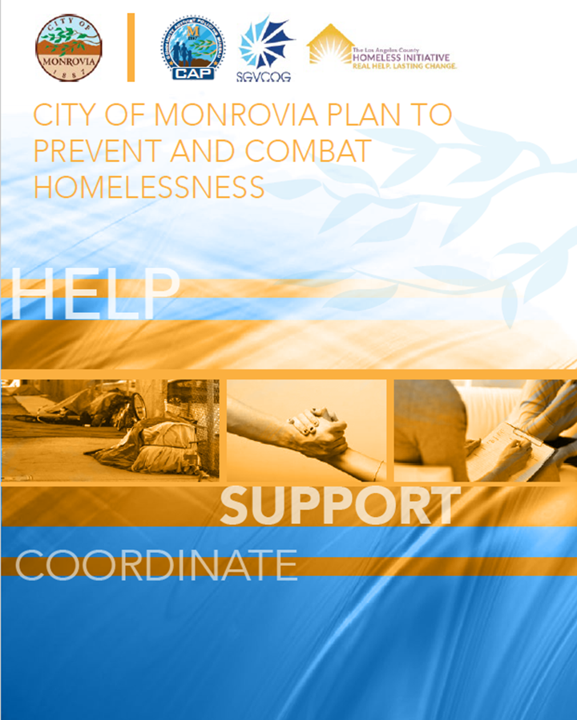
MONROVIA’S RESPONSE
In an effort to respond to this community challenge, on July 17, 2018 the City Council adopted:
City of Monrovia
Plan to Prevent and Combat Homelessness
The plan includes five strategies all focusing on:
  Helping those in need
  Supporting our community partners
  Responding in a coordinated effort

Slide 4
Goal 1:
Be Relentless in Contacting the Homeless
The City has developed existing mechanisms through which we relentlessly contact those individuals experiencing homeless frequently
They may not be ready for assistance today, but when they are ready we want to be there

Slide 5
Goal 2:
Expand Community Coordination
There are a multitude of service providers in Monrovia and in the greater SGV area
Developing better service coordination between all of these different entities is an essential component to ending homelessness
Enhanced communication and coordination

Slide 6
Goal 3:
Promote Use of the CES
The CES aims to integrate all homeless housing and service delivery needs through one integrated platform to reduce the time that those are homeless and link individuals to supportive services
  Promote the use of the CES on the City's website and on resource guides
  Host community meetings to update the public about use of the CES
  Provide community education at the Monrovia Area Partnership conferences, Neighborhood Watch meetings, and Chamber of Commerce meetings

Slide 7
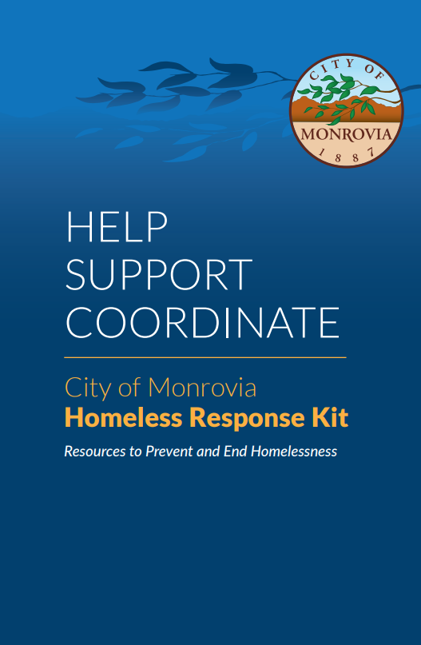
Goal 4:
Develop Updated Educational Materials
Work to develop better educational materials to promote homeless response options
Staff has created a practical toolkit for the public that outlines tangible ways individuals can help address homelessness issues
The City of Monrovia Homeless Response Kit
can be downloaded on the City website:
WWW.CITYOFMONROVIA.ORG/HOMELESS-SERVICES

Slide 8
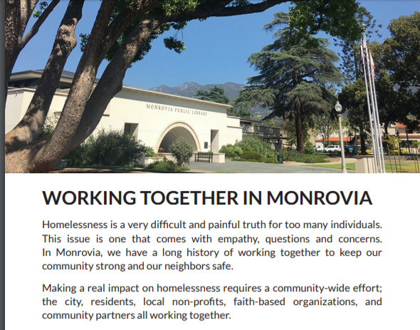
Goal 5:
Housing Displacement Response Plan
Unfortunately, life can create challenging circumstances and place families in an immediate housing crisis.
The loss of a job or a significant illness of the primary household provider can be devastating and result in homelessness.
The intent of the Housing Displacement Response Plan (HDRP) is to prevent Monrovia residents from experiencing homelessness by providing a “hand-up” to support those in danger of displacement.

Slide 9
Housing Displacement Response Plan
Who is eligible?
The family in need must be relationally connected to a faith community, school, or nonprofit organization in Monrovia.
The family must be experiencing circumstantial acute financial distress and meet two (2) of the following descriptions:
  Children attending a Monrovia based school
  Received an eviction notice
  Diagnosed with a disability
  Resident in Monrovia for 7+ years
  Family consists of a single parent; or the second parent is no longer working due to job loss, illness, or incarceration
  Individual is elderly
  Primary household provider is being deported from the United States
  Family is between housing

Slide 10
Housing Displacement Response Plan
What is it and how does it work?
Key to the success of the program is the Advocate.
It is about the relationships. We are here to help one another.
The Advocate assesses the situation and identifies housing need.
The Advocate works with the family to complete an Assessment Form and conducts a site visit.
A Sustainability or Transitional Plan, which may include entry into the Coordinated Entry System, is developed.
The Request is reviewed based on the established criteria, the overall assessment, and the need, financial assistance is paid directly to the landlord, utility company, etc.
Advocates are encouraged to continue to work with the family through their established relational connection and follow up regularly in order to track effectiveness of assistance.

Slide 11
Housing Displacement Response Plan
What is it and how does it work?
The City has allocated $100,000 to the program and
received an additional $90,000 from the SGVCOG to support the program.
The HDRP program is administered in partnership with Mountainside Communion.
If you would like more information about getting your faith community involved, please email: housing@mountainsidecommunion.org

Slide 12
ACHIEVING REAL RESULTS WITH HDRP!
Since May 2018, the HDRP program has…
Avoided displacement for 39 families = $70,690
$1,813 per family
$752 per individual
Prevented 45 youth from having to leave Monrovia schools
Prevented 39 adults and 10 seniors from losing their homes
Engaged 21 Community Organizations as Family Advocates

Slide 13
Building on our Success
Emergency COVID Housing Impact Program (eCHIP) Pilot Program
Due to the pandemic, and the eviction moratorium, the need for HDRP slowed.
However, it became very clear that families were being put in the position of possibly facing housing displacement in the future as a result of direct COVID-19 related impacts.
As a result, the City development eCHIP to fill in the crucial gap that allowed for one-time financial assistance for families that wouldn’t otherwise be eligible for HDRP.
The Pilot Program was aimed at serving individuals and families facing imminent housing displacement as a result of direct COVID-19 related impacts.
Follow the HDRP model to administer the eCHIP funds.
Residents were referred to the program through existing advocates comprised of local service providers, schools and faith communities.

Slide 14
ACHIEVING REAL RESULTS WITH eCHIP!
Since October 2020, the eCHIP program has…
Provided one-time assistance to 77 families = $127,500
$1,656 per family
$450 per person
156 adults have been assisted
6 seniors have been assisted
121 children have been assisted

Slide 15
New Branch of HDRP
Family and Advocate Support Services (FASS)
With the expiration of the COVID-19 eviction moratoriums, housing insecurity is now at its worse. Situations are more complicated.
Aimed at addressing the growing needs of the HDRP clients by offering enhanced resources through wrap around care and Multidiscipline Case Management
  Housing navigation, mental health services, food insecurity, health and wellness, etc.
  Designed to serve the unique needs of each family.
Case Managers will be provided by Foothill Unity Center and serve clients at the Monrovia Community Center.
Program is targeted to begin in January 2022 – more details to follow.

Slide 16
ULTIMATE GOAL
Prevent Homelessness and keep families in their homes!
Not only is it the “right” thing to do, it is a more cost effective solution.
According to National Alliance to End Homelessness, February 2017
“An individual experiencing homeless
can costs the taxpayer an average of $35,578 per year”
We are positions to help more families in both the HDRP and eCHIP program.
If you would like more information about getting your faith community involved, please email: housing@mountainsidecommunion.org

Slide 17
QUESTIONS?

