Slide 1
Conditional Use Permit CUP2015-12
108 East Colorado Boulevard
Applicant, Julie Kalicki

Slide 3
CUP2015-08/Drive-Thru Facility
CUP required for drive-thru within 100 feet of a residential zone
RH zone to the east
CUP2015-09/Late Night Operations
CUP required for a business that operates between midnight and 6:00 a.m. within 100 feet of a residential zone
Proposal is to operate from 4:00 a.m. to midnight
Though the project site is adjacent to a residential zone, there are no residential developments adjacent to the site

Slide 4
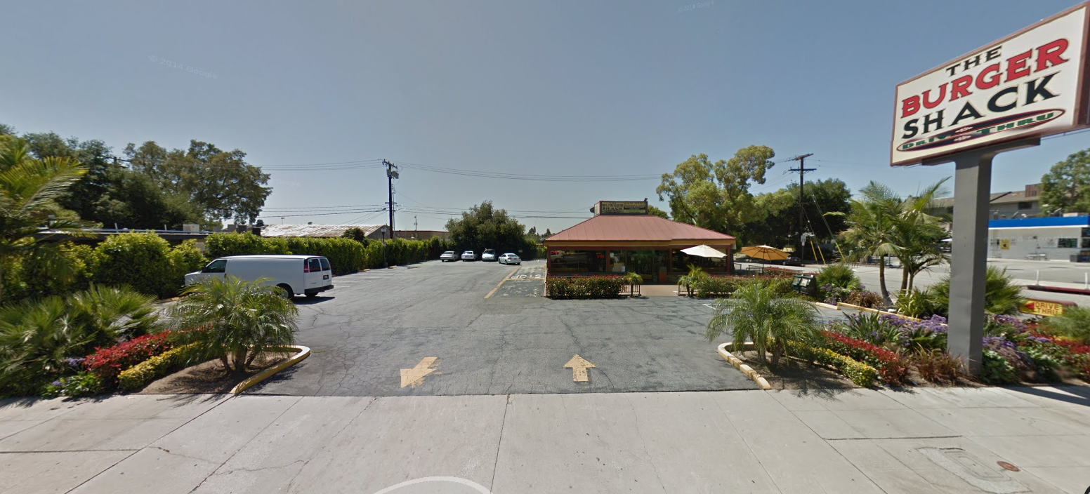
Existing Restaurant and
Drive-Thru

Slide 5
Site Plan
Existing restaurant to be demolished
New 950 sf building
Drive-thru to accommodate 10 cars
10 parking spaces
Meets zoning requirements

Slide 6
Queueing Analysis
Starbucks Corporation standard - 8 cars
Site allowance – 10 cars
Onsite directional signage
Condition to review use within 3 months of commencement of operations

Slide 7
Additional Information - Traffic Counts
School not in session during summer months
Historic information provides total traffic counts on Foothill Boulevard between Fifth and Mayflower Avenues

Slide 8
Additional Information – Bus Dispatch and Return
9 Buses
Morning – Leave site between 6:30 a.m. and 6:40 a.m.; Return between 8:30 a.m. and 9:00 a.m.
Afternoon - Leave site between 1:15 p.m. and 1:30 9.m.; Return between 3:30 p.m. and 4:00 p.m.

Slide 9
Additional Information – Window Service Times
Initial study referenced 32 second window service time (Fairplex Drive adjacent to I-10 Freeway location)
Applicant provided video of window service times at Highland and Melrose Avenues Starbucks location

Slide 10
Additional Information – Potential Traffic Mitigation Measures
Traffic Safety Committee will review the use after 3 months of operation for potential traffic impacts
City Engineer compiled potential offsite mitigation measures to address specific traffic impacts

Slide 11
Conclusion
CUPs required for drive-thru and late night operations
Mitigation measures regarding onsite queueing
Mitigation measures regarding potential offsite traffic impacts
Zoning requirements met

