Slide 1
Conditional Use Permit CUP2016-02 (Service and Sales of Wine and Beer)
Conditional Use Permit CUP2016-03 (Live Entertainment)
124-126 West Pomona Avenue
Applicant, REV Winery/REV Brewing Co.

Slide 2
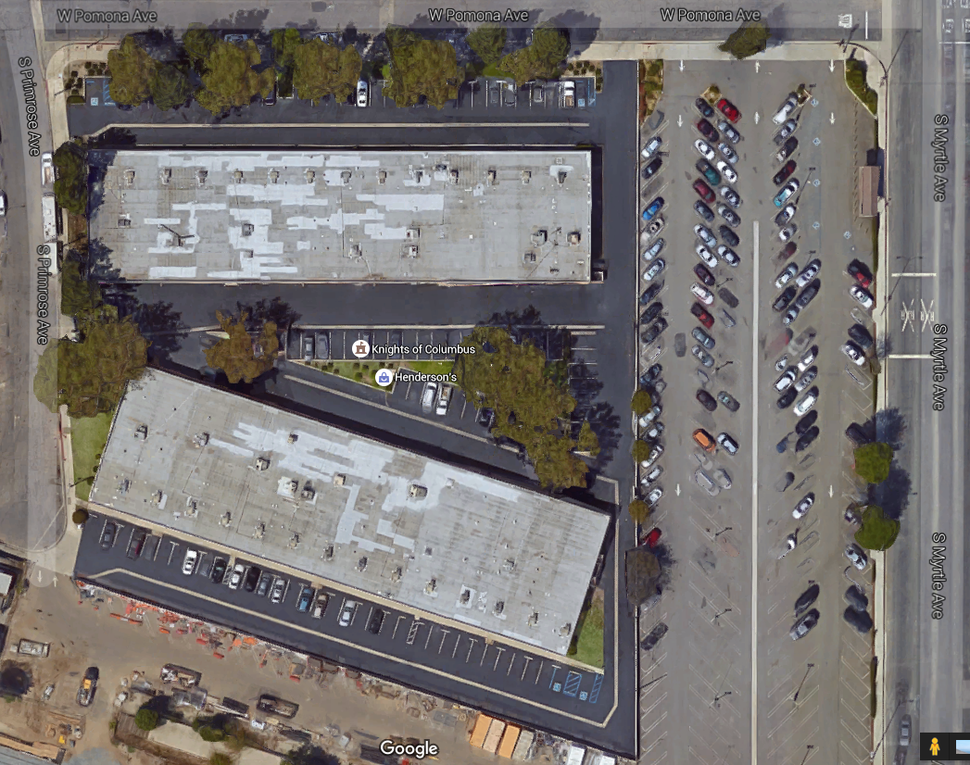
Subject Site
Subject Units

Slide 4
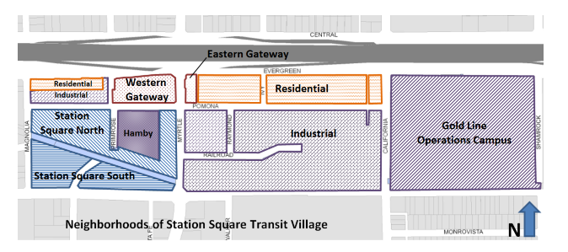
General Plan Map

Slide 5
CUP2016-02/CUP2016-03
Approval of a Conditional Use Permit (CUP) is required when alcoholic beverages are sold or served for on-site consumption and when the facility is located within 500 feet of any residential zone, park, school, recreation center, religious assembly or hospital (§17.44.025). REV Winery/REV Brewing Co. is located within the PD-12 land use designation, which allows residential uses. The subject site is also within 500 feet of the new park at Station Square.
A CUP is also required for live indoor acoustic entertainment.

Slide 8
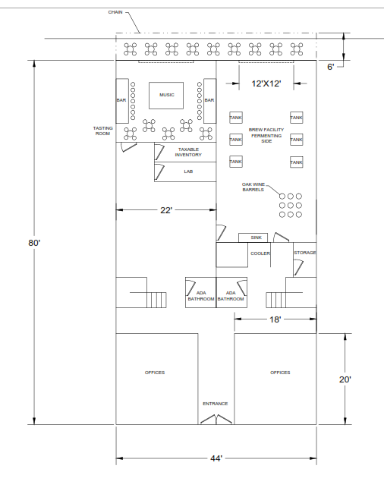
First Floor

Slide 9
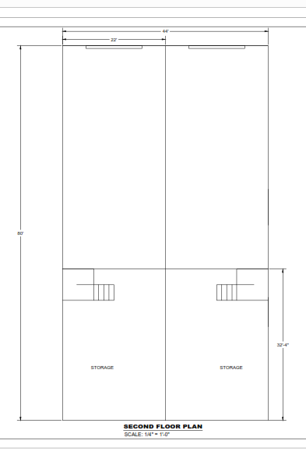
Second Floor

Slide 11
